Slide 1

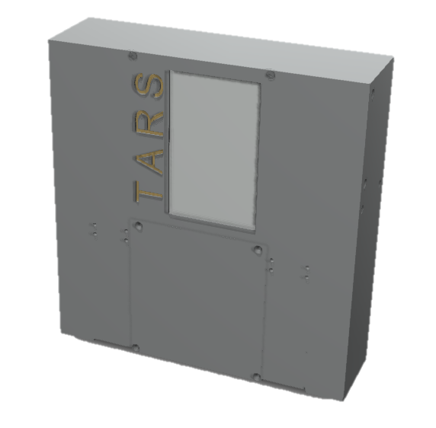
TARS Instructions
Screws Needed:
6 M20
40 M14
76 M10

Slide 2
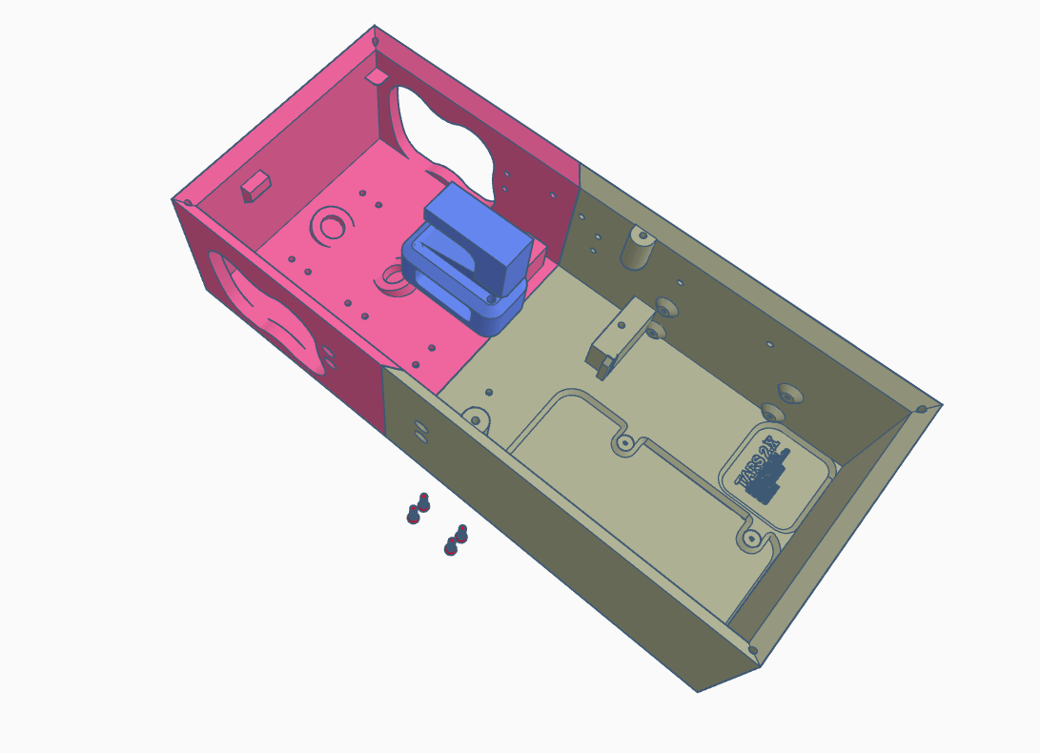
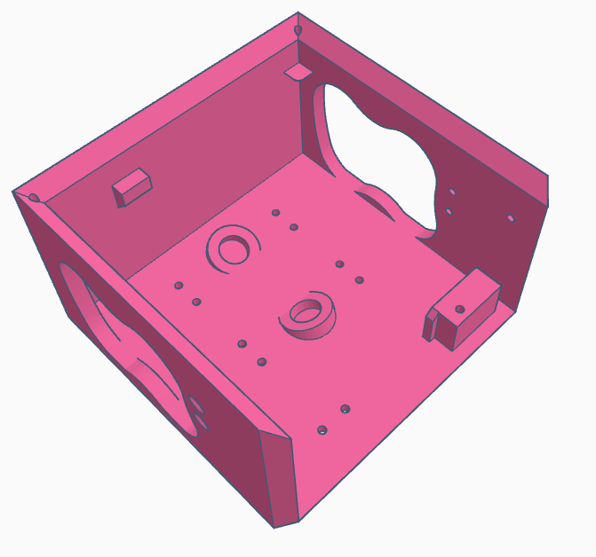
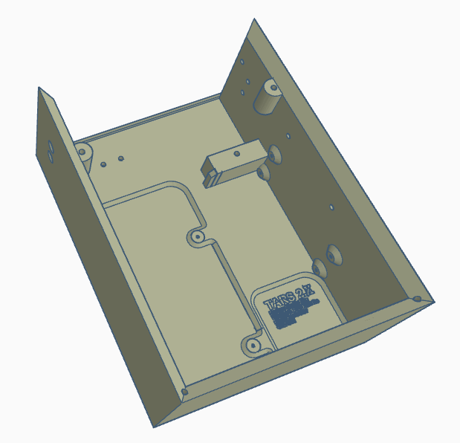
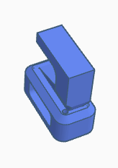
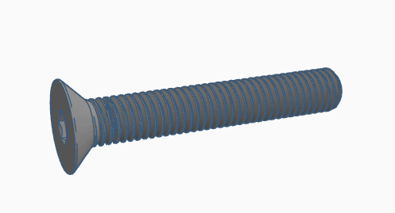
Chassis Upper (v9)
Chassis Lower (v9)
Chassis Connector Screen Support
M3 20MM x4

Slide 3
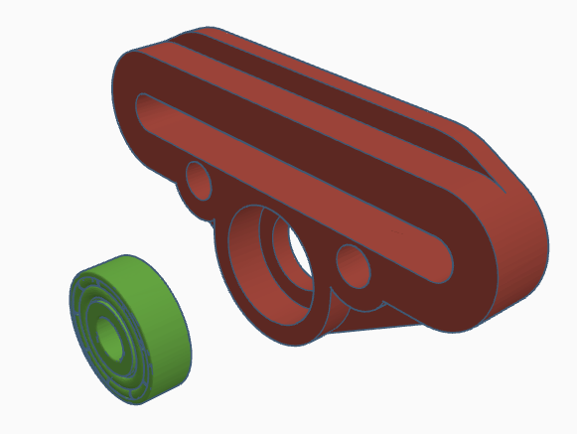
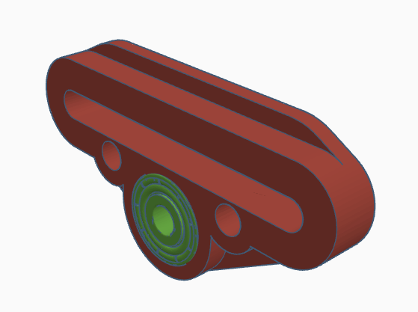
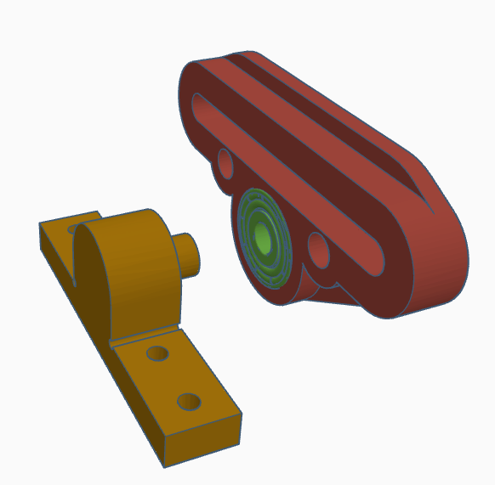
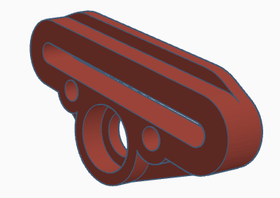
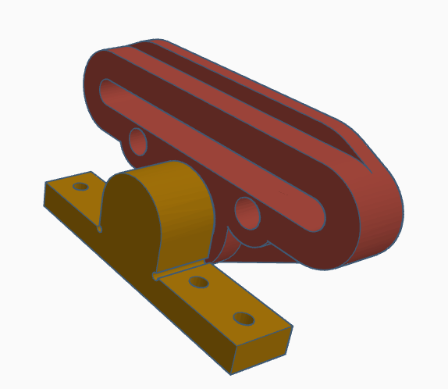
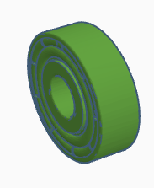
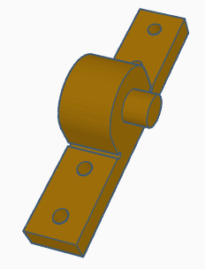
x2
Arm Spring Divider
(left and Right)
608 Bearing
(metal or Printed)
Arm Suspension Mount

Slide 4
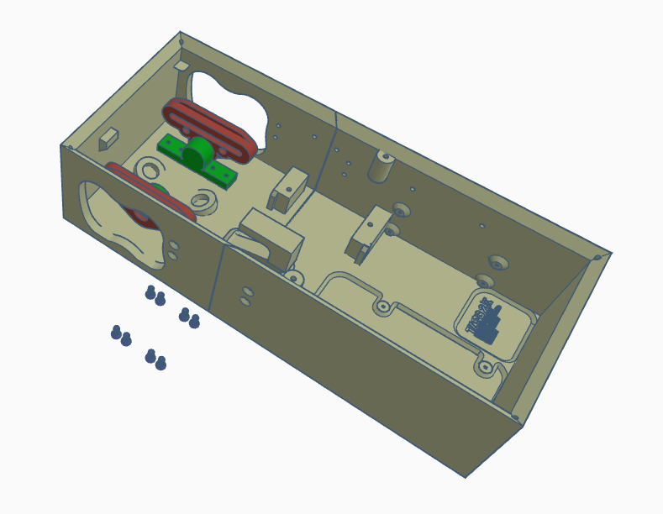
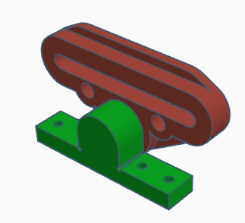
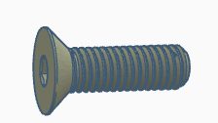
Assembly from previous step x2
Arm Suspension Mount x8

Slide 5
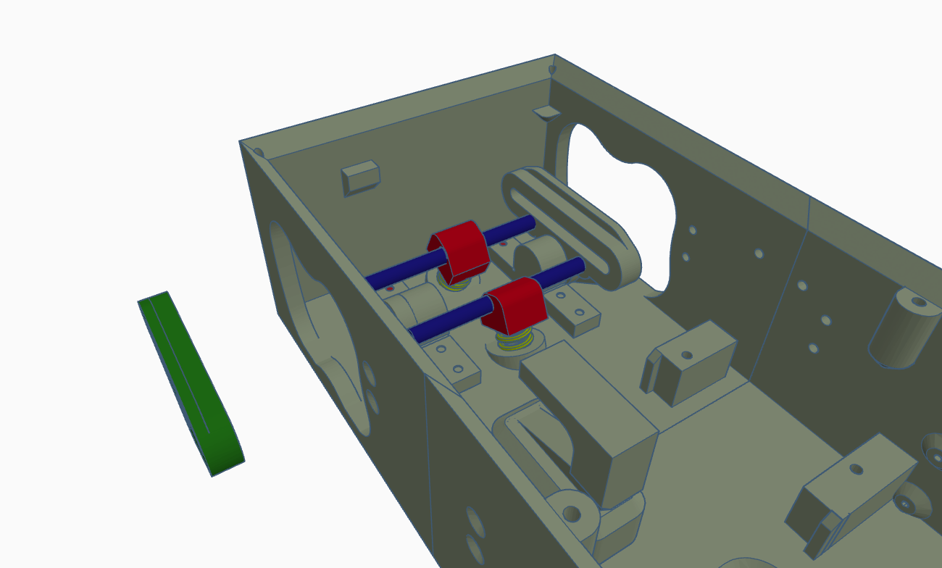
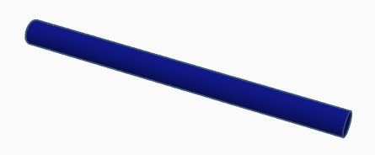

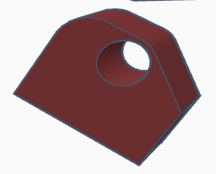
Secondary Axle x2
Spring x2
Upper Strut Mount x2

Slide 6
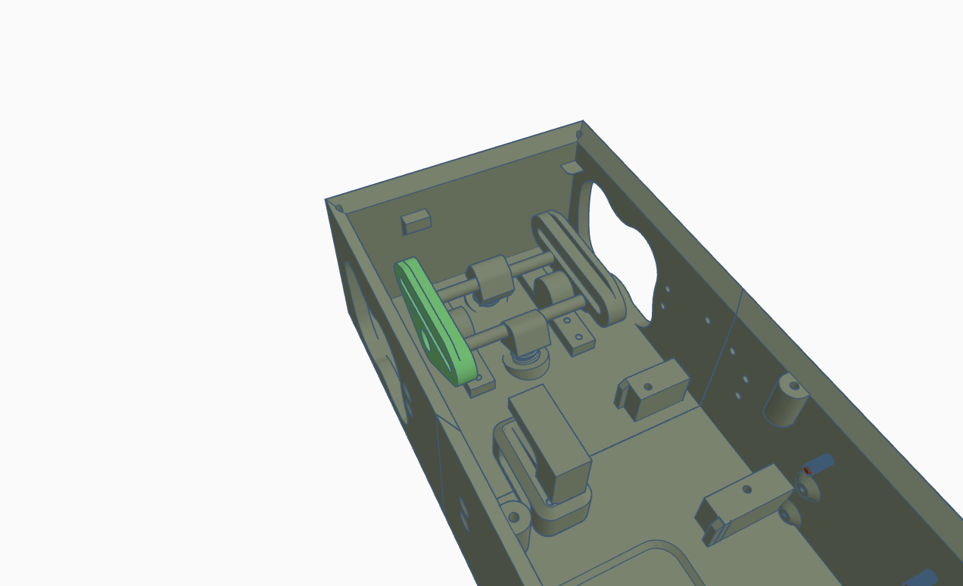
Reinstall

Slide 7
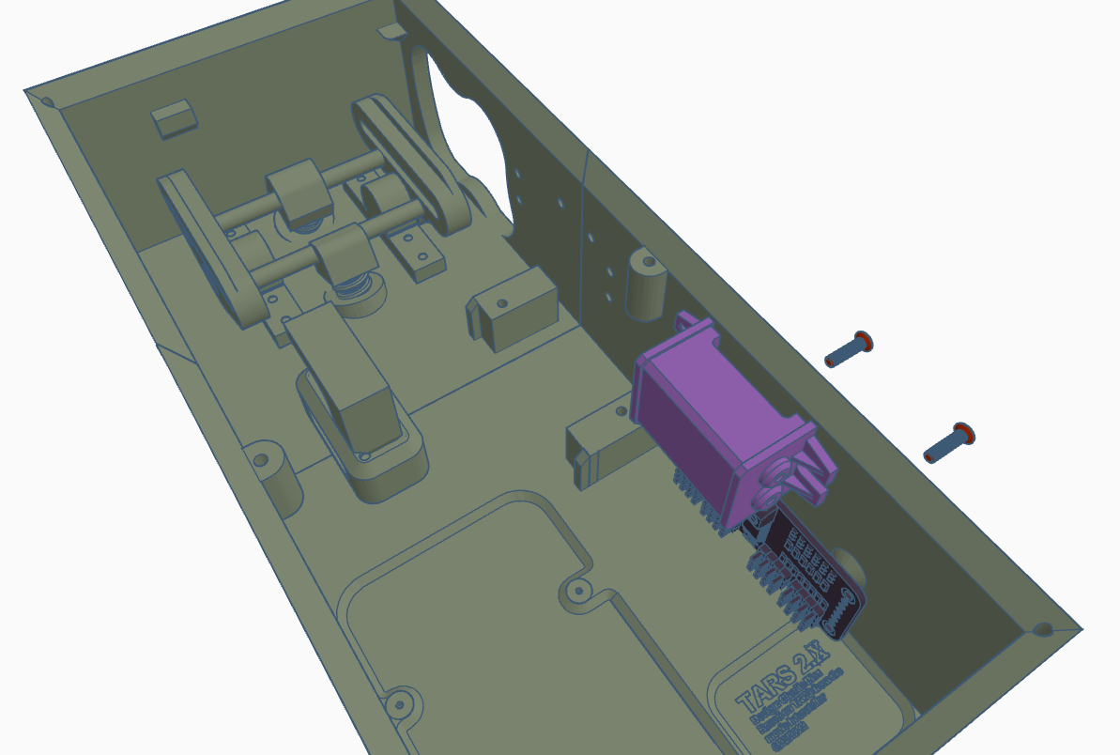
Secure the 12 ch PWM board to the wall with 4 M2*4 screws (use a flat tip by hand)
Connect the 6v out wires to the
Secure the 12v to 6v Buck convertor with 2 M3*10 screws

Slide 8
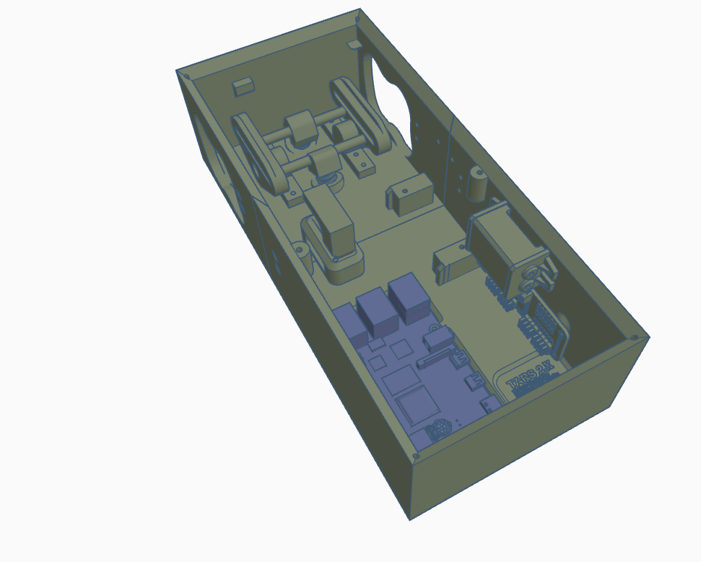
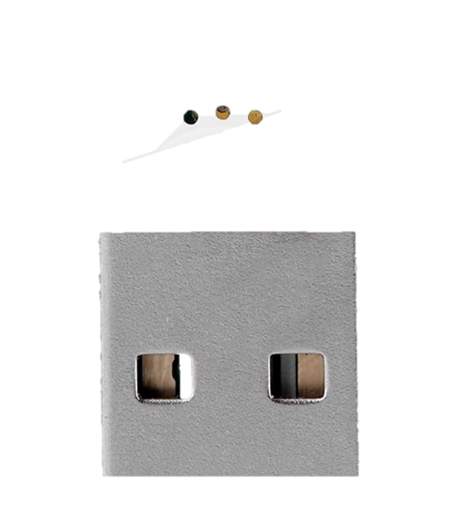
Insert the USB MIC into the RPI
(Not shown here)
Insert the RPI and secure with 4 M2*4 screws. DO NOT OVER TIGHTEN OR USE LONGER SCREWS

Slide 9
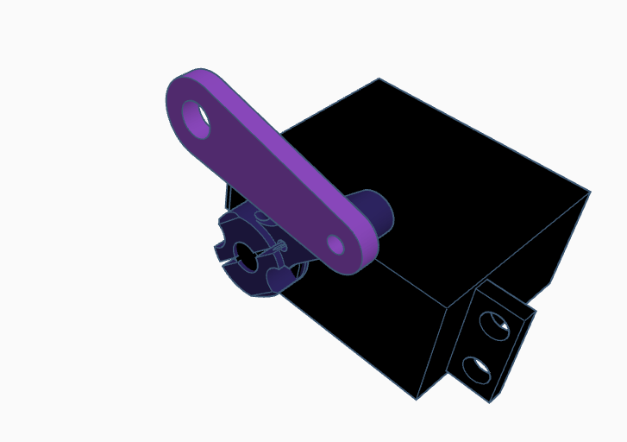
“5 Pack ShareGoo 25T Aluminum Servo Horns M3 Threads Metal Steering Arm for RC Car Truck Buggy Airplane-Black”
Attach a METAL !!! (unable to print it WILL strip) 25T Aluminum Servo Horn with M3 Threads to the servo using supplied hardware.
Attach upper connecting rod arm with M3*12 screw like arrow shown

Slide 10
IMPORTANT STEP!!!!!!!
Connect Servos to the Servo Controller:
Attach the center servo to the first set of pins on the servo controller (Pin 0).
Connect the robot's left (port) arm to the next set of pins (Pin 1).
Connect the robot's right (starboard) arm to the following set of pins (Pin 2).
Connect the PWM Servo Controller to the Raspberry Pi:
Use the servotester.py script to determine the minimum and maximum PWM values the servo can operate within.
Calculate the dead center value (midpoint) between the minimum and maximum PWM values.
Manually attach the arms at the midpoint position to ensure proper alignment.
Update the Configuration File:
Add the determined center PWM value as neutral to the config.ini file. Add 50 to neutral for up and subtract 50 for down limits.
Center the Arms Mechanically:
Using the servo test tool, set each arm's servo channel to a midpoint value, such as 350 (between the typical range of 100-600).
Detach the arms, reposition them to align mechanically with the center position, and then reattach them.
This ensures the arms are mechanically centered at the specified midpoint value (e.g., 350). For example if you set 350 they should be vertical and perfectly straight.
Calibrate the Center Servo:
Set the center servo to its lowest position (e.g., 88) using the servo test tool.
Reposition and reattach the center servo to align with the lowest point.
Define this position (e.g., 88) as UPHEIGHT in the config.ini file.

Slide 11
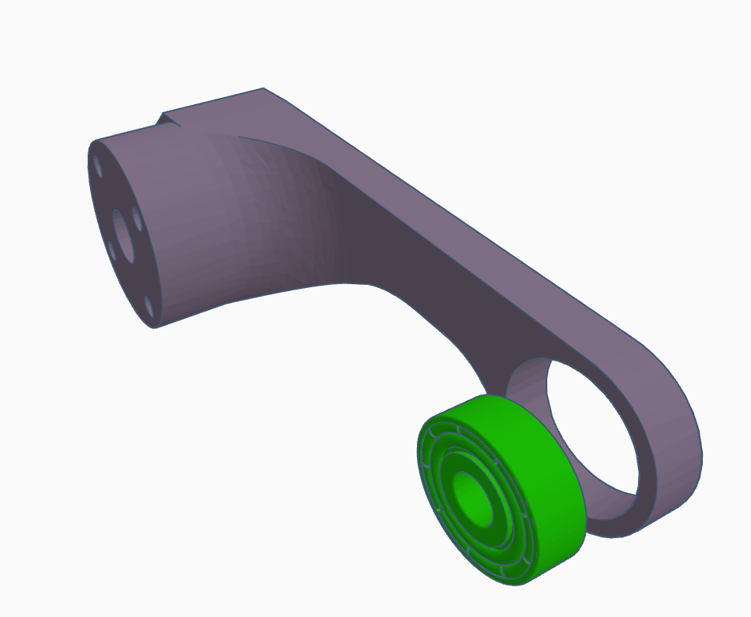
x2
Press in the 608 bearing (metal or printed) in the Arm Left / Right Mount

Slide 12
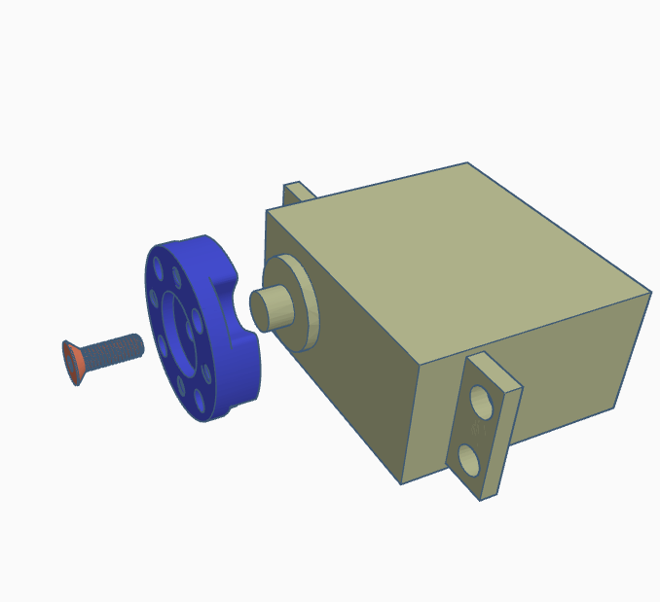
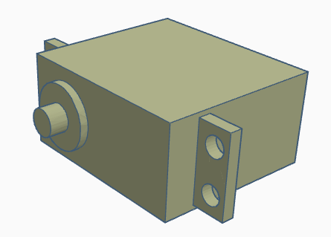
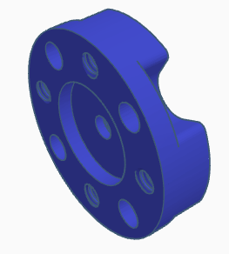

x2
Connect servo to RPI first, the PORT and STARBOARD servos should go in pine 1 and 2 (the first pin is 0).
Servo
Arm Upper Servo Horn
Servo Horn Screw

Slide 13
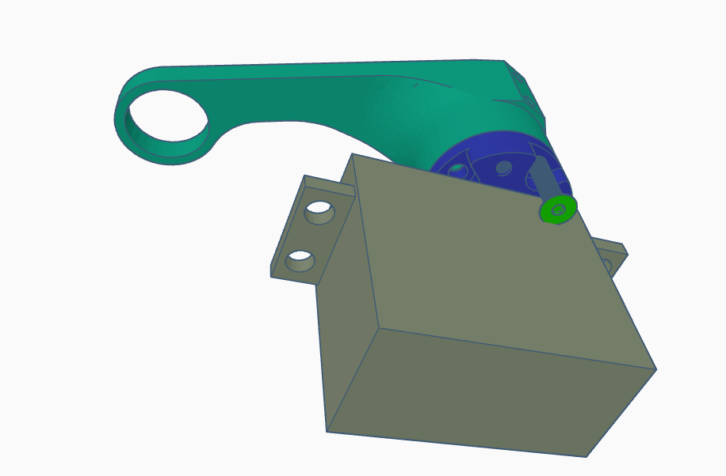
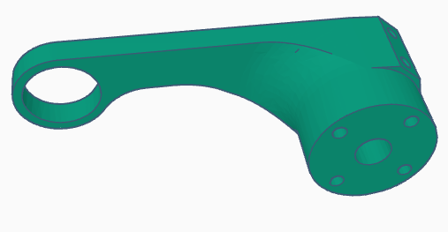
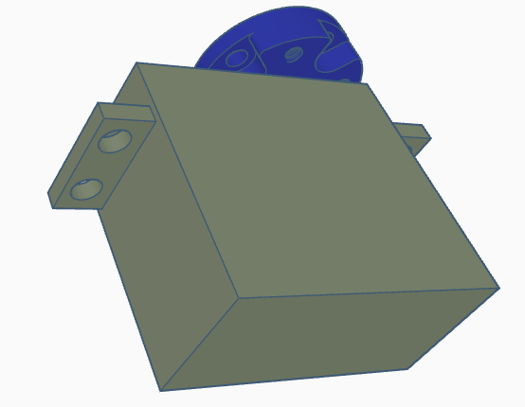

x2
Servo
Arm Upper Servo Horn
M3 14MM x4
*Rotate the servo to align the bolts

Slide 14
x2
Servo
Arm Upper Servo Horn
M3 14MM x4
*Rotate the servo to align the bolts

Slide 15
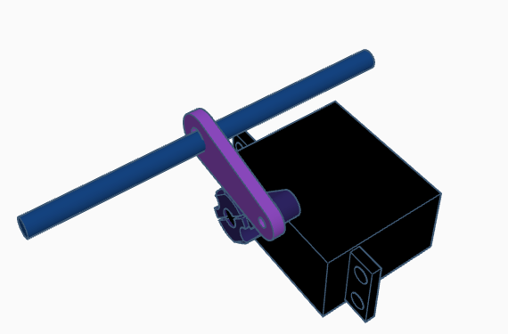
Insert secondary Axle main lifting rod into center servo.

Slide 16
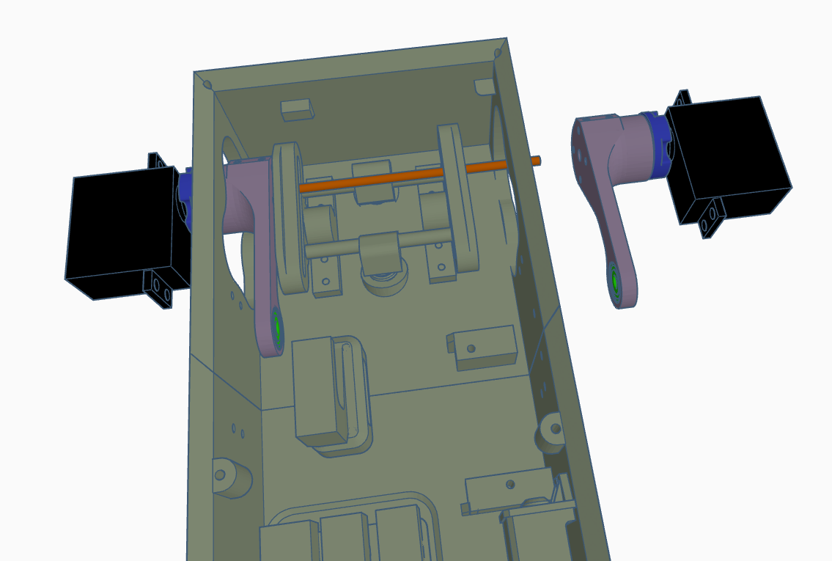
Slide the Left arm mount in
Slide in upper rod and screw into place.
Repeat process on
right side

Slide 17
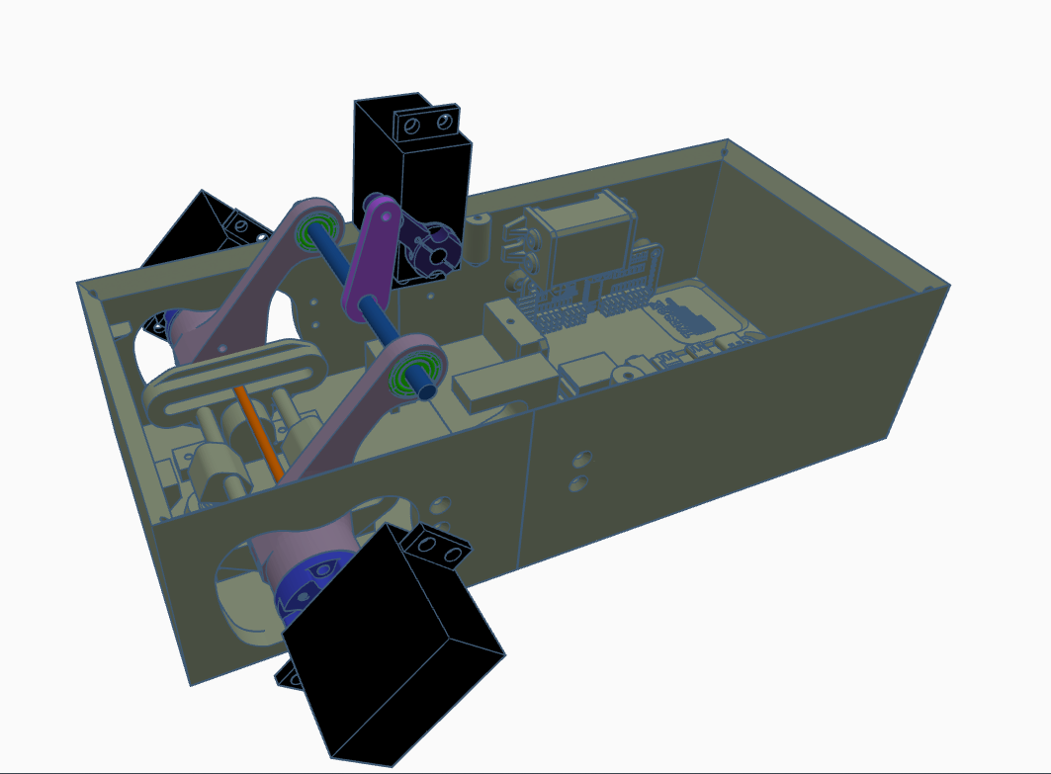
Rotate main arms and slide in center servo rod assembly.

Slide 18
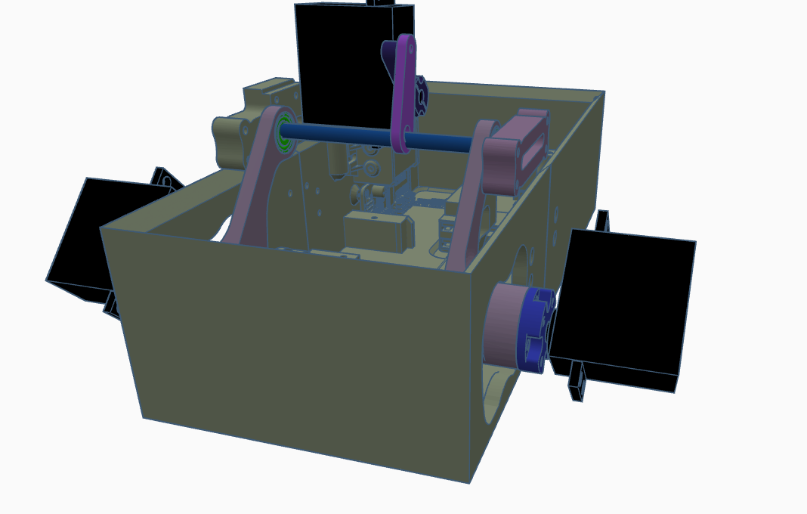
Slide on main body mounts

Slide 19
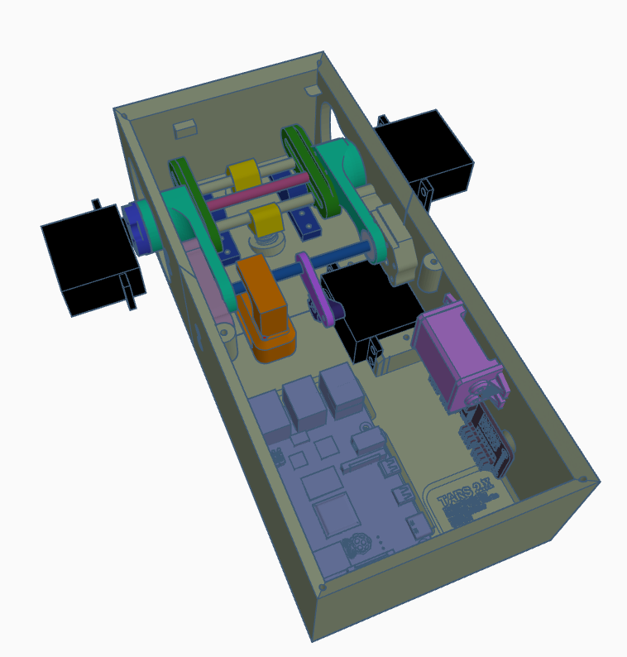
Rotate entire assembly into place
Secure sides with m4*10 screws

Slide 20
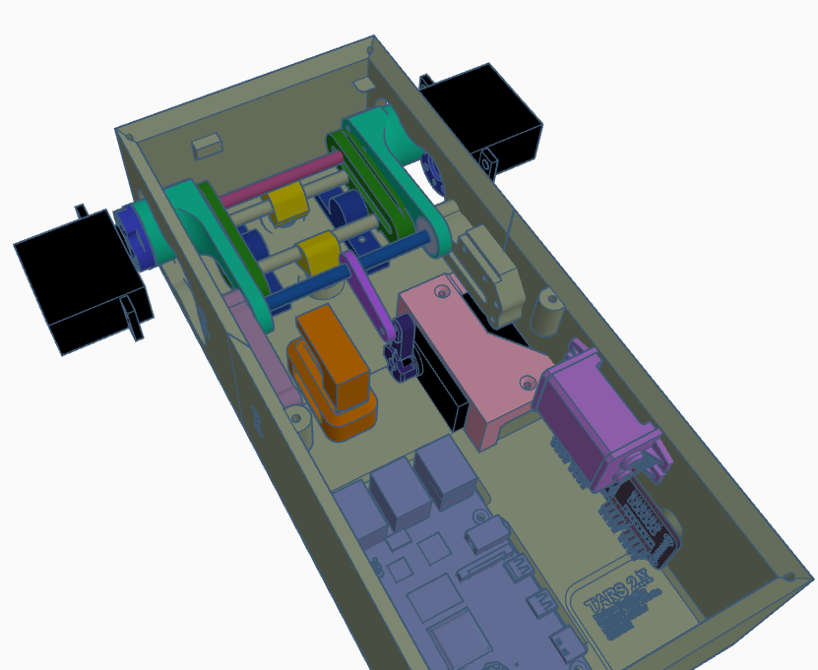
Slide Arm assembly up and attach
Center servo bracket.

Slide 21
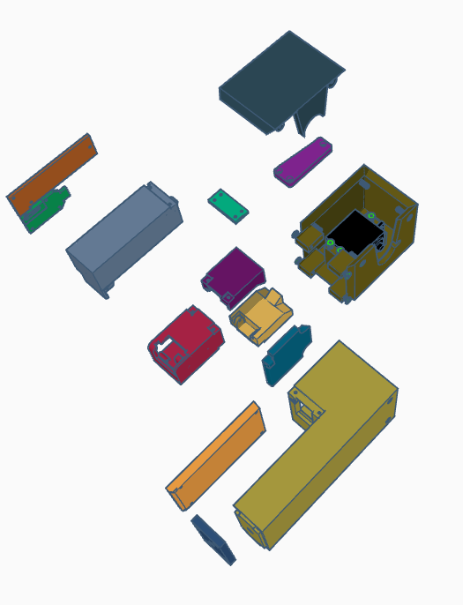
x2
Each arm is assembly like the picture

